Slide 1
Week-3
Session-1
Understanding Economics and How It Affects Business

Slide 2
Topics to be Covered
The major branches of economics
Resource development
Key Economic Indicators
The Invisible Hand Theory
Free market Capitalism, foundations of capitalism, Socialism and Communism
The Trend Towards Mixed Economies
Competition within Free Markets
Demand and its determinants
Supply and its determinants
Equilibrium, shortage and surplus

Slide 3
The Major Branches of Economics
Economics:
The study of how society employs resources to produce goods and services and distribute them for consumption among various competing groups and individuals.
It is the science of scarcity.
Macroeconomics: The branch of economics that focuses on the operation of a nation’s economy as a whole.
Microeconomics: The branch of economics that focuses on the behavior of people and organizations in markets for particular products or services.

Slide 4
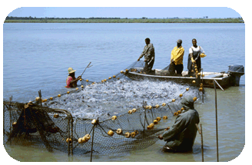
Resource Development
Resource Development: The study of how to increase resources and create conditions that will make better use of those resources.
New energy sources (hydrogen fuel for autos)
New ways of growing food (hydroponic)
New ways of creating needed goods and services (mariculture and nanotechnology).

Slide 5
Key Economic Indicators
GDP: The total value of final goods and services produced in a country in a given year.
Unemployment Rate: The percentage of civilians at least 16 years old who are unemployed and tried to find a job within the prior four weeks. Types of unemployment include frictional, structural, cyclical and seasonal.

Slide 6
GDP (continued)
Included in GDP:
Final goods and services sold for money.
Not included in GDP:
unpaid work: work performed within the family, volunteer work, etc.
goods not produced for sale in the marketplace
bartered goods and services
black market
illegal activities
sales of used goods
intermediate goods and services that are used to produce other final goods and services

Slide 7
Key economic indicators
Inflation is a general rise in the prices of goods and services over time.
Deflation means that prices are declining; It occurs when countries produce so many goods that people cannot afford to buy them all.
Recession: Two or more consecutive quarters of decline in the GDP.

Slide 8
The Business Cycle
Business cycles are the periodic rises and falls that occur in economies over time.
The four phases of long-term business cycles are:
1. An economic boom is business is booming.
2. Recession is two or more consecutive quarters of decline in the GDP.
3. A depression is a severe recession, usually accompanied by deflation.
4. A recovery occurs when the economy stabilizes and starts to grow. This eventually leads to an economic boom, starting the cycle all over again.

Slide 9
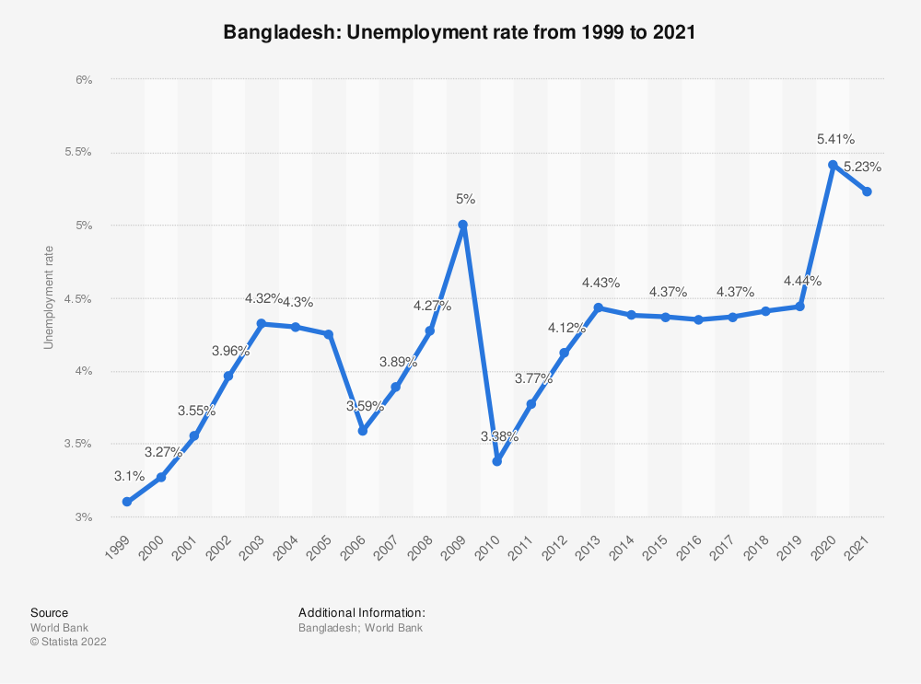
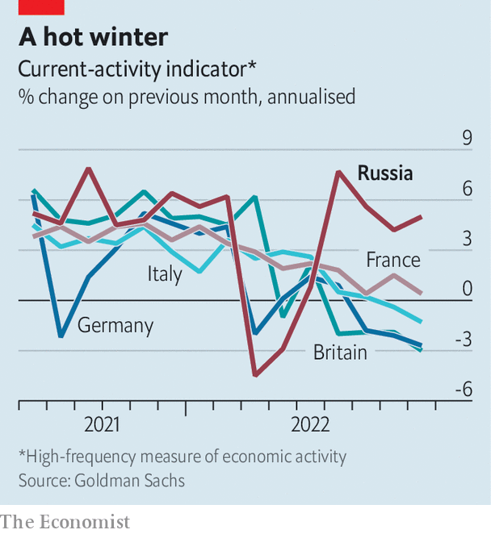
Key Economic Indicators (continued)

Slide 10
Macroeconomic policy objectives
The four key macroeconomic policy objectives:
Low Inflation
Low unemployment
Stable economic growth
A good current account and capital account position
Monetary Policy: **An economic policy whereby the Central bank controls the money supply, strategically changes the interest rate, manages inflation, unemployment and maintains currency exchange rates.
Fiscal Policy: Government Policy whereby Government aims to achieve its objectives through government expenditure and taxation.

Slide 11
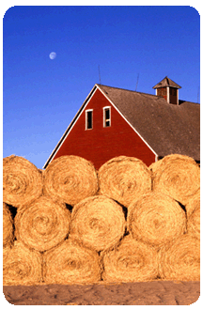
The Invisible Hand Theory
Invisible Hand: A phrase coined by Adam Smith to describe the process that turns self-directed gain into social and economic benefits for all.
The term "invisible hand" theory first appeared in Adam Smith's famous work "The Wealth of Nations" to describe how free markets can motivate individuals, acting in their own self-interest, to produce what is societally necessary.

Slide 12
Free market Capitalism
Free market: A free market is one in which decisions about what and how much to produce are made by the market.
Capitalism: An economic system in which all or most of the factors of production and distribution are privately owned and operated for profit.
Foundations of Capitalism:
The right to own private property.
The right to own a business and keep all that business’ profits.
The right to freedom of competition.
The right to freedom of choice.

Slide 13
Socialism and Communism
Socialism: An economic system based on the premise that some, if not most, basic businesses should be owned by the government so that profits can be more evenly distributed among the people.
Communism: An economic and political system in which the government makes almost all economic decisions and owns almost all the major factors of production.

Slide 14
References
Arnold, R. A. (2014) Macroeconomics (11th ed.). South-Western.
Mankiw, N.G. (2018) Principles of Microeconomics (8th ed.). Cengage Learning.
Nickels, W. G., McHugh, J. M. & McHugh, S. (2014) Understanding Business (11th ed.). McGraw-Hill.

